Slide 1






Department of Computer Science
EARLY DETECTION OF LUNG CANCER NODULES THROUGH CAPSULE NEURAL NETWORK
Presented By Aizaz Shabber Khan
Registration No: 2024(S)-MS-DS-06
Full Time: Yes
Supervisor: Dr Ayesha Altaf
Department: Data Science

Slide 2






Abstract
Lung cancer is among the leading causes of cancer-related deaths worldwide, primarily due to delayed diagnosis and limited accessibility to expert radiological interpretation. This research proposes an advanced deep learning approach utilizing Capsule Neural Networks (CapsNets) for the early detection of lung cancer nodules in CT scan images. Unlike conventional Convolutional Neural Networks (CNNs), CapsNets preserve spatial hierarchies and relationships between image features through dynamic routing, enhancing diagnostic accuracy even with smaller datasets. The study aims to design, implement, and evaluate multiple CapsNet architectures, comparing their performance with CNN-based models in terms of accuracy, sensitivity, specificity, and false positive rates using the LIDC-IDRI dataset. Experimental analysis will explore computational efficiency, training stability, and real-world deployment feasibility of CapsNet-based systems. The findings are expected to contribute to developing efficient, accurate, and scalable AI-assisted diagnostic frameworks, supporting early detection and reducing lung cancer mortality.

Slide 3


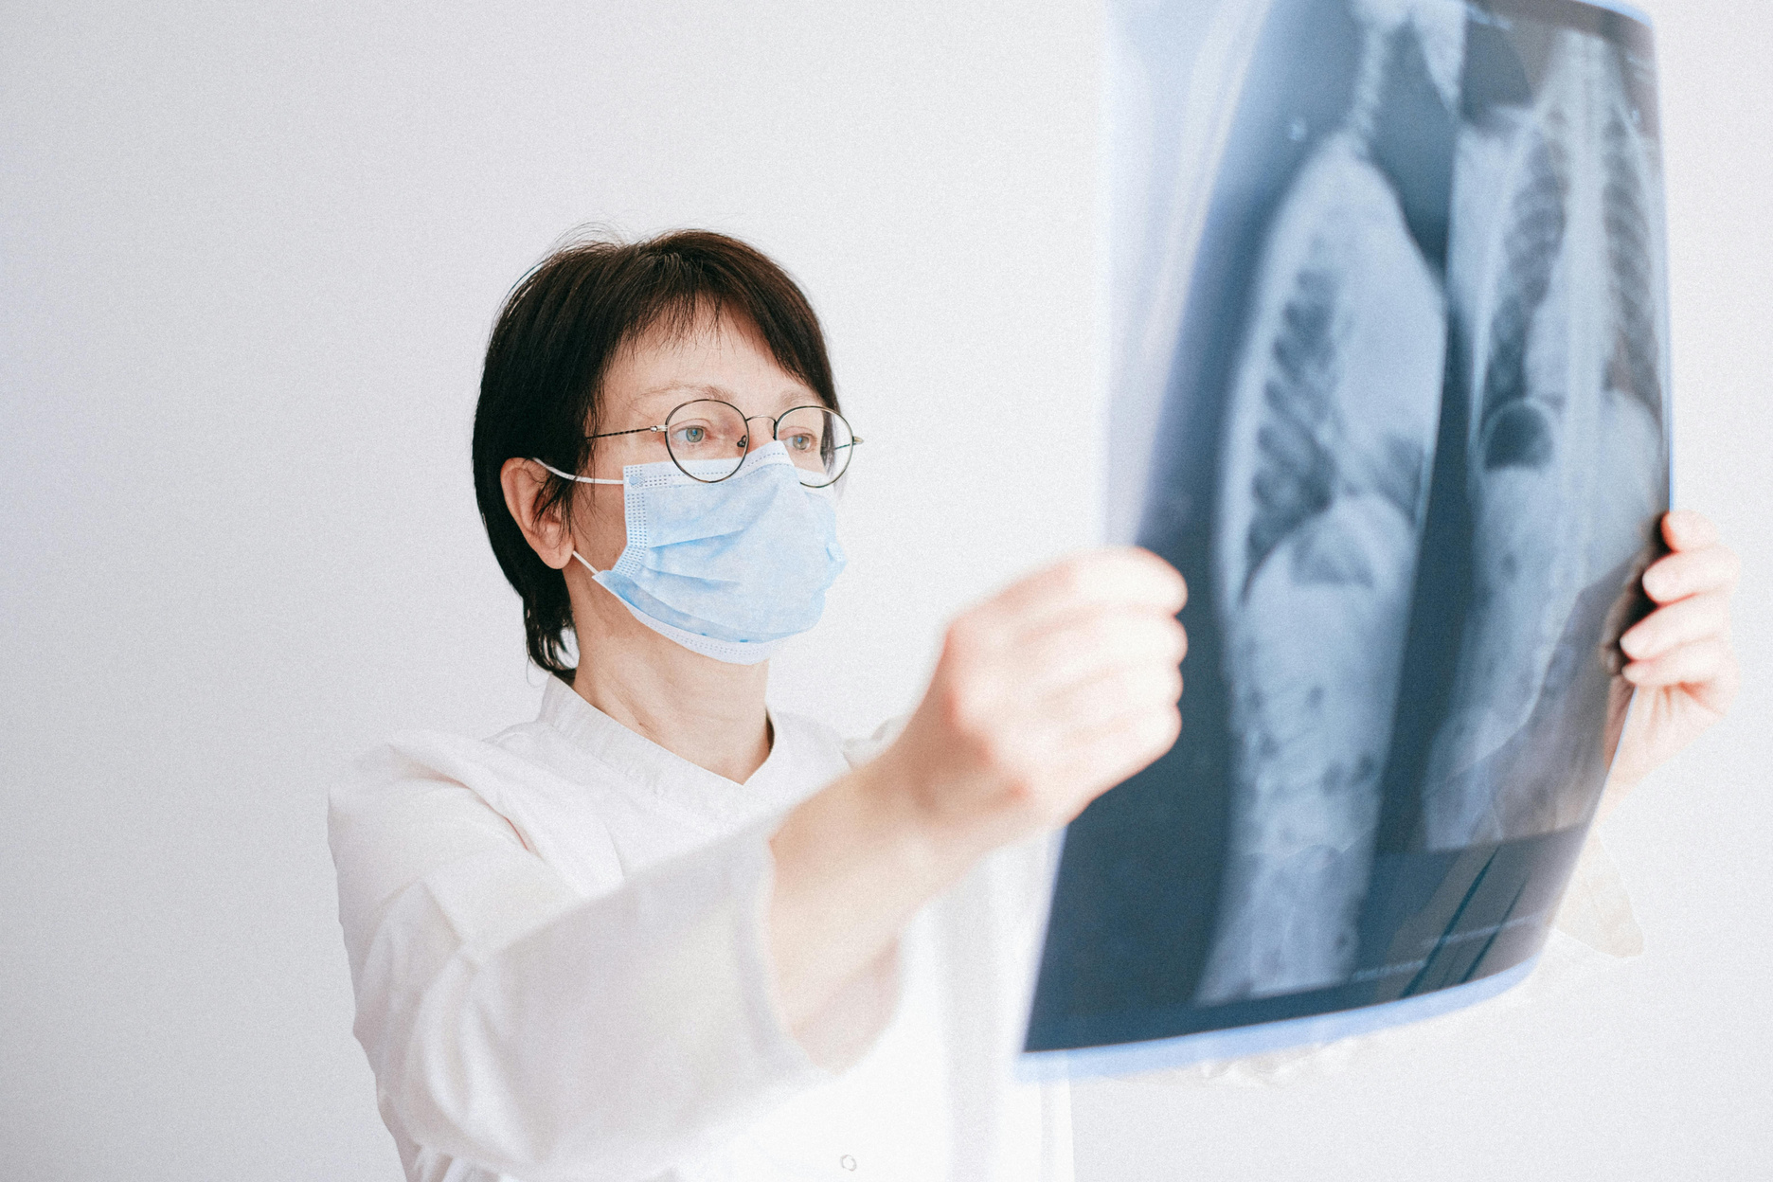


Introdutcion
Lung cancer remains one of the leading causes of death worldwide.
Early detection significantly improves patient survival rates.
CT imaging and computer-assisted diagnosis (CAD) systems help identify lung nodules.
Convolutional Neural Networks (CNNs) have shown potential but suffer from spatial information loss.
Capsule Neural Networks (CapsNets) preserve spatial hierarchies and may improve diagnostic accuracy.

Slide 4





Overview
01
Problem Statement
05
Utilization of Research Results
02
Research Objectives
06
Research Outcomes
03
Literature Survey
07
Research Timetable
04
Methodology
08
References

Slide 5
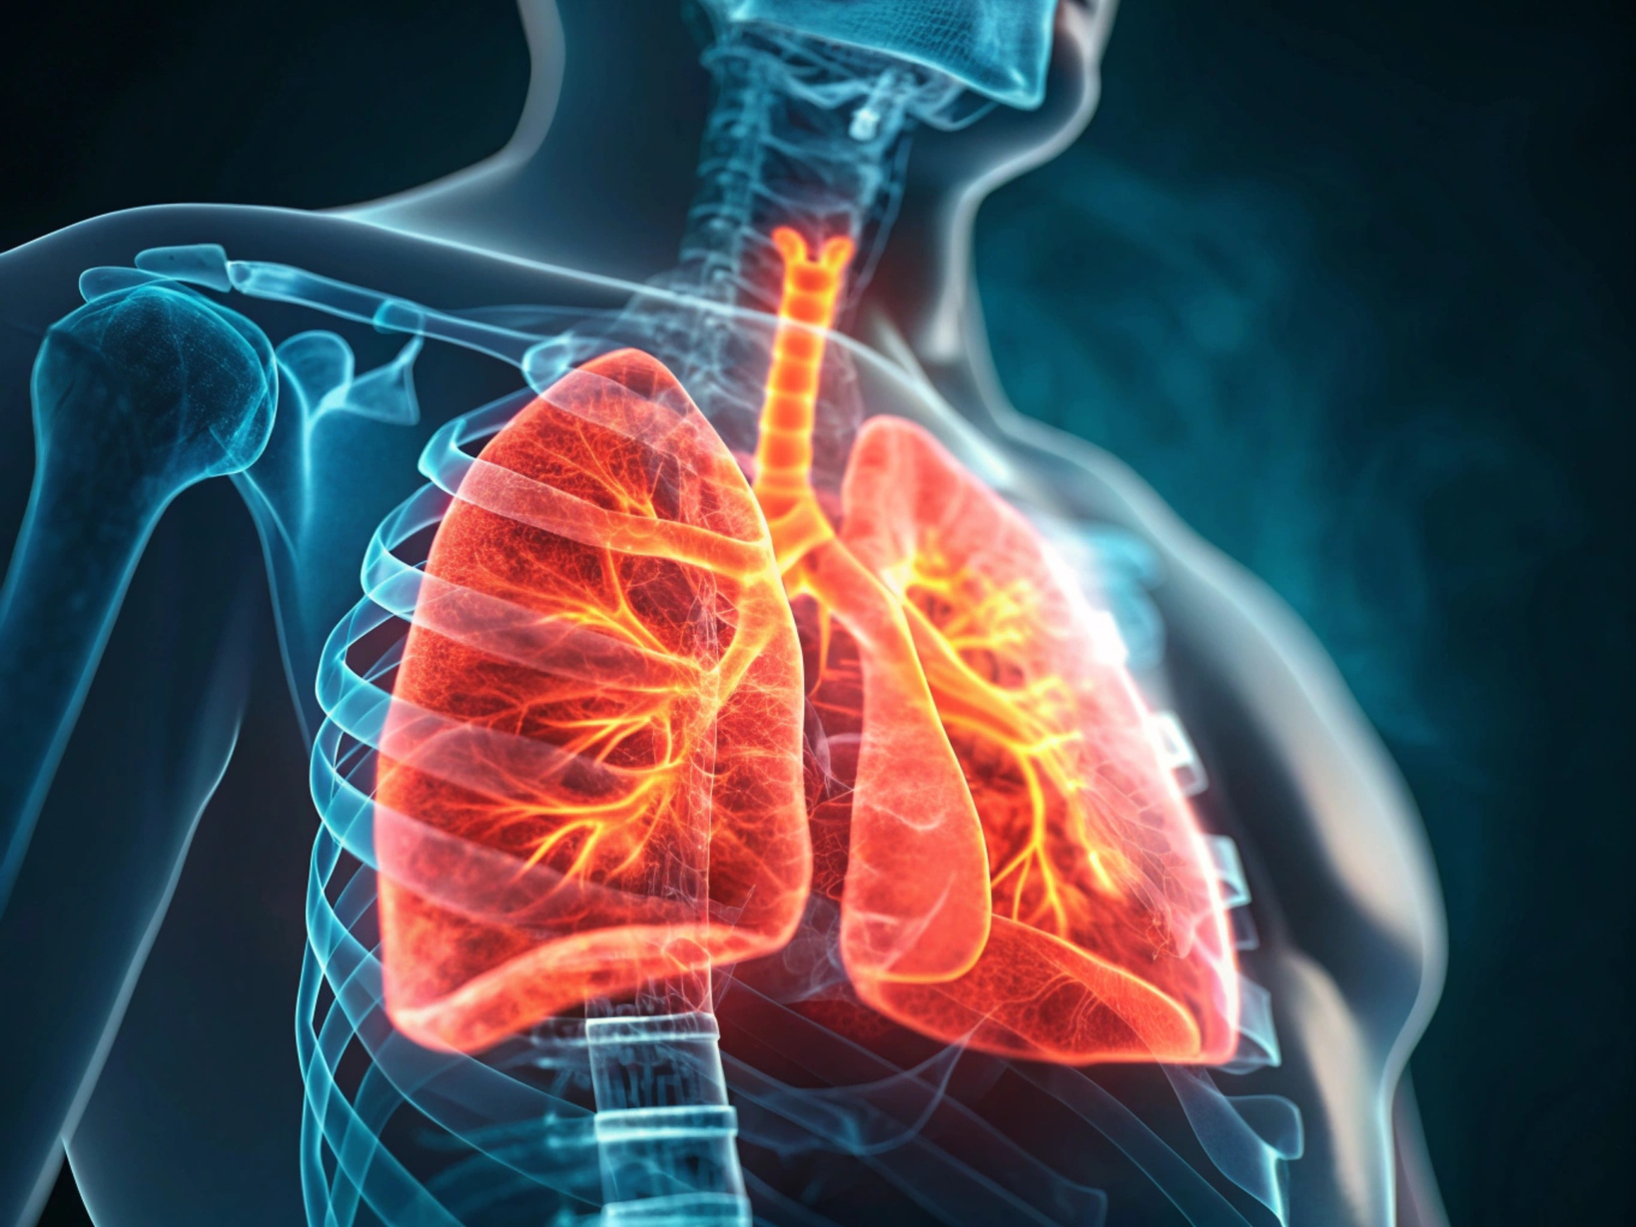
Problem Statement
Lung cancer is one of the leading causes of mortality worldwide.
Early detection through CT screening helps reduce deaths but diagnosis remains challenging.
CNN-based models often suffer from spatial information loss and high false-positive rates.
Capsule Neural Networks (CapsNets) preserve spatial hierarchies.
Limited empirical research comparing CNN and CapsNet for lung nodule detection.

Slide 6
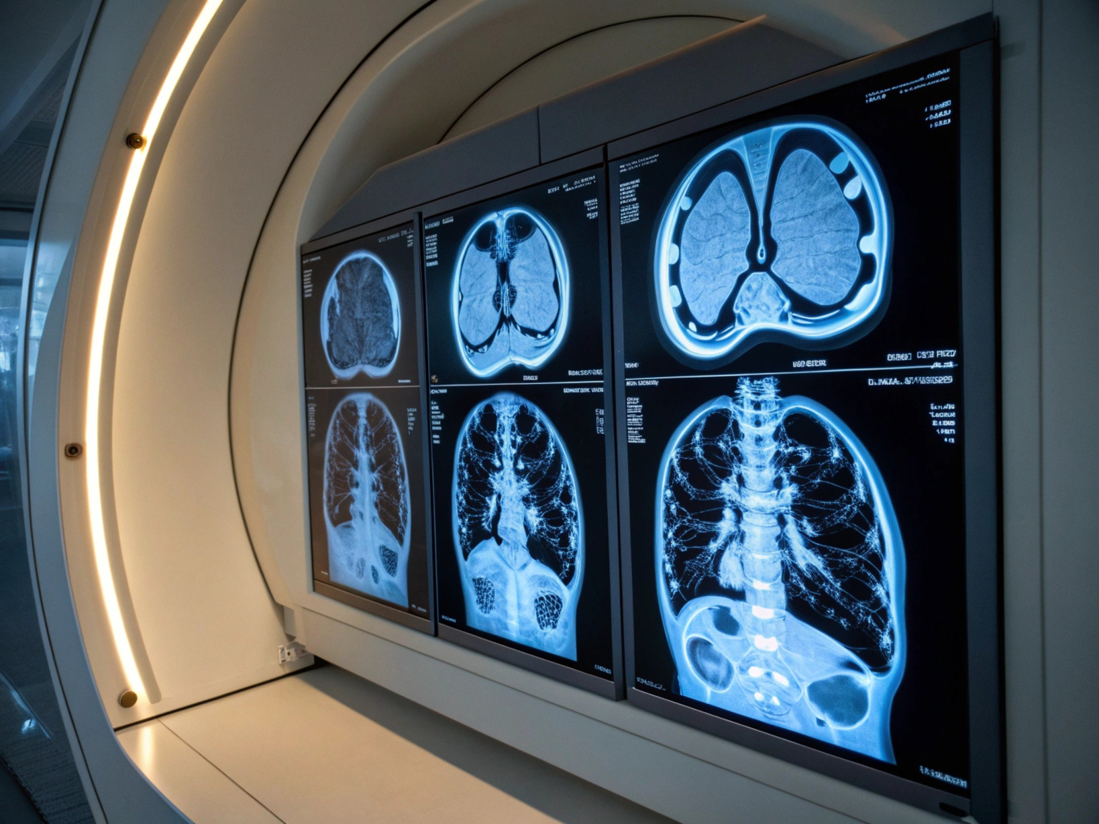
Research Objectives
Analyze limitations of CNN approaches.
Design optimized Capsule Neural Network architectures using dynamic routing.
Develop models for accurate classification.
Evaluate performance using accuracy, sensitivity, and specificity.
Propose deployable CapsNet-based diagnostic frameworks.

Slide 7
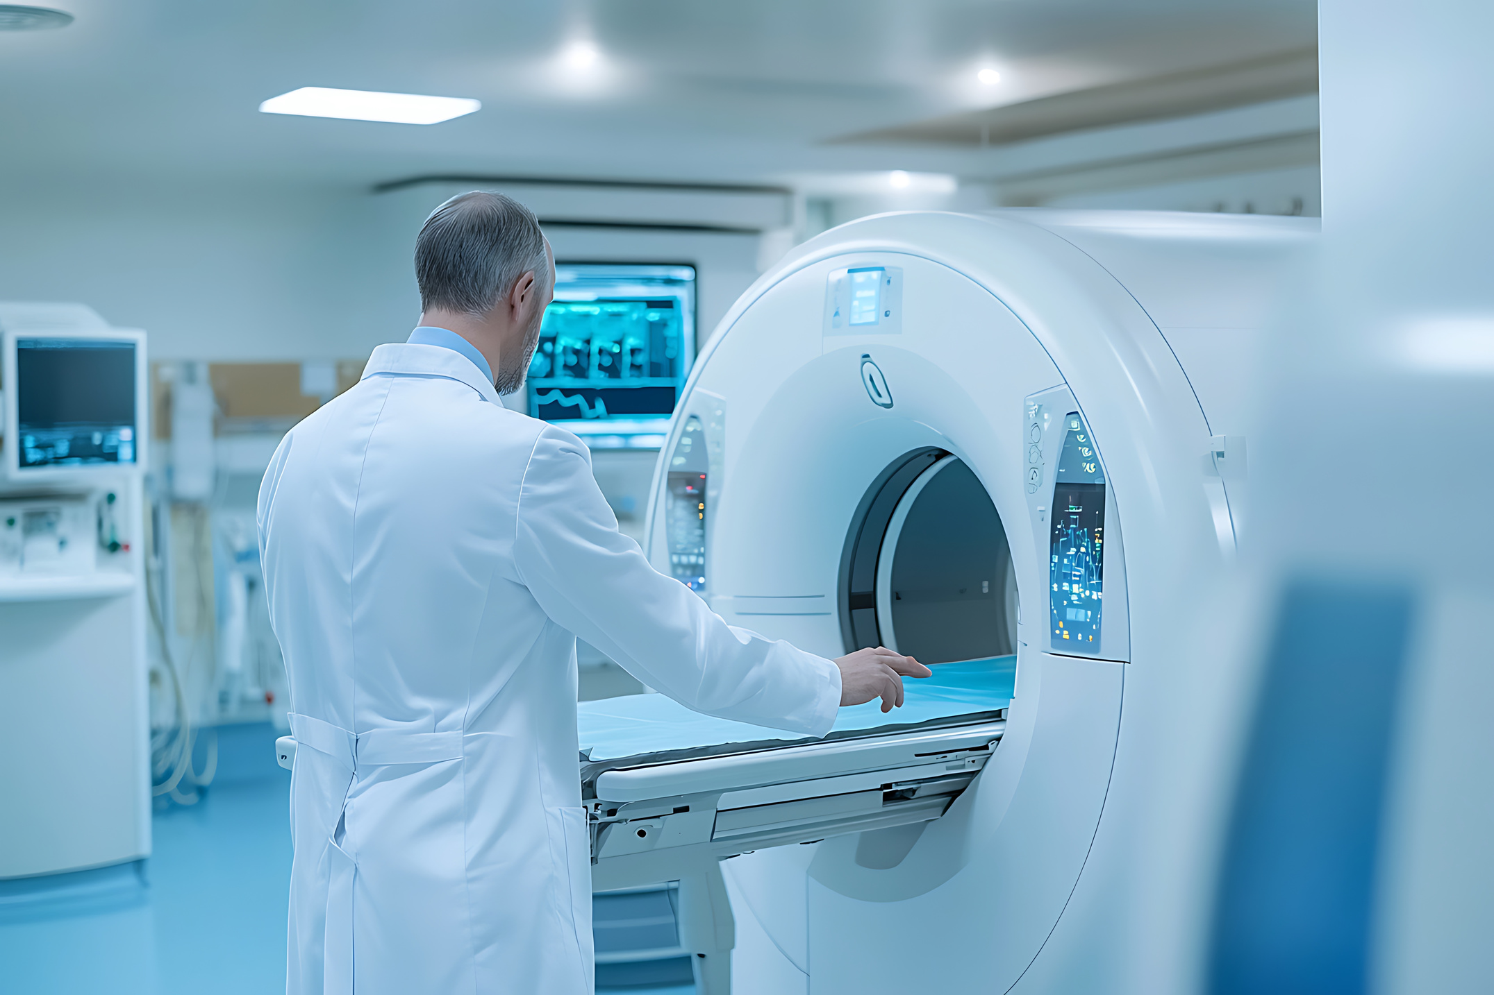


Literature Survey
Lung cancer remains a major cause of death globally [9].
CNN models achieved up to 84% accuracy but face false positives [8].
Max pooling operations in CNNs cause spatial information loss [5].
CNNs require large datasets and risk overfitting [1].
Deep CNNs (5k–160M parameters) achieve high sensitivity but lack generalization [7].
CapsNets introduced dynamic routing to preserve spatial hierarchies [4].
Studies like LUNA16 benchmarked lung nodule detection [6].
•• Research gap: lack of comparative analysis between CNN and CapsNet.

Slide 8
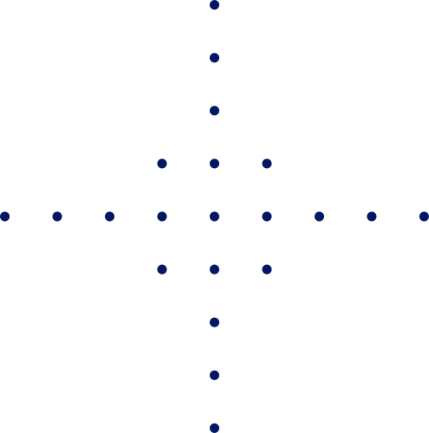
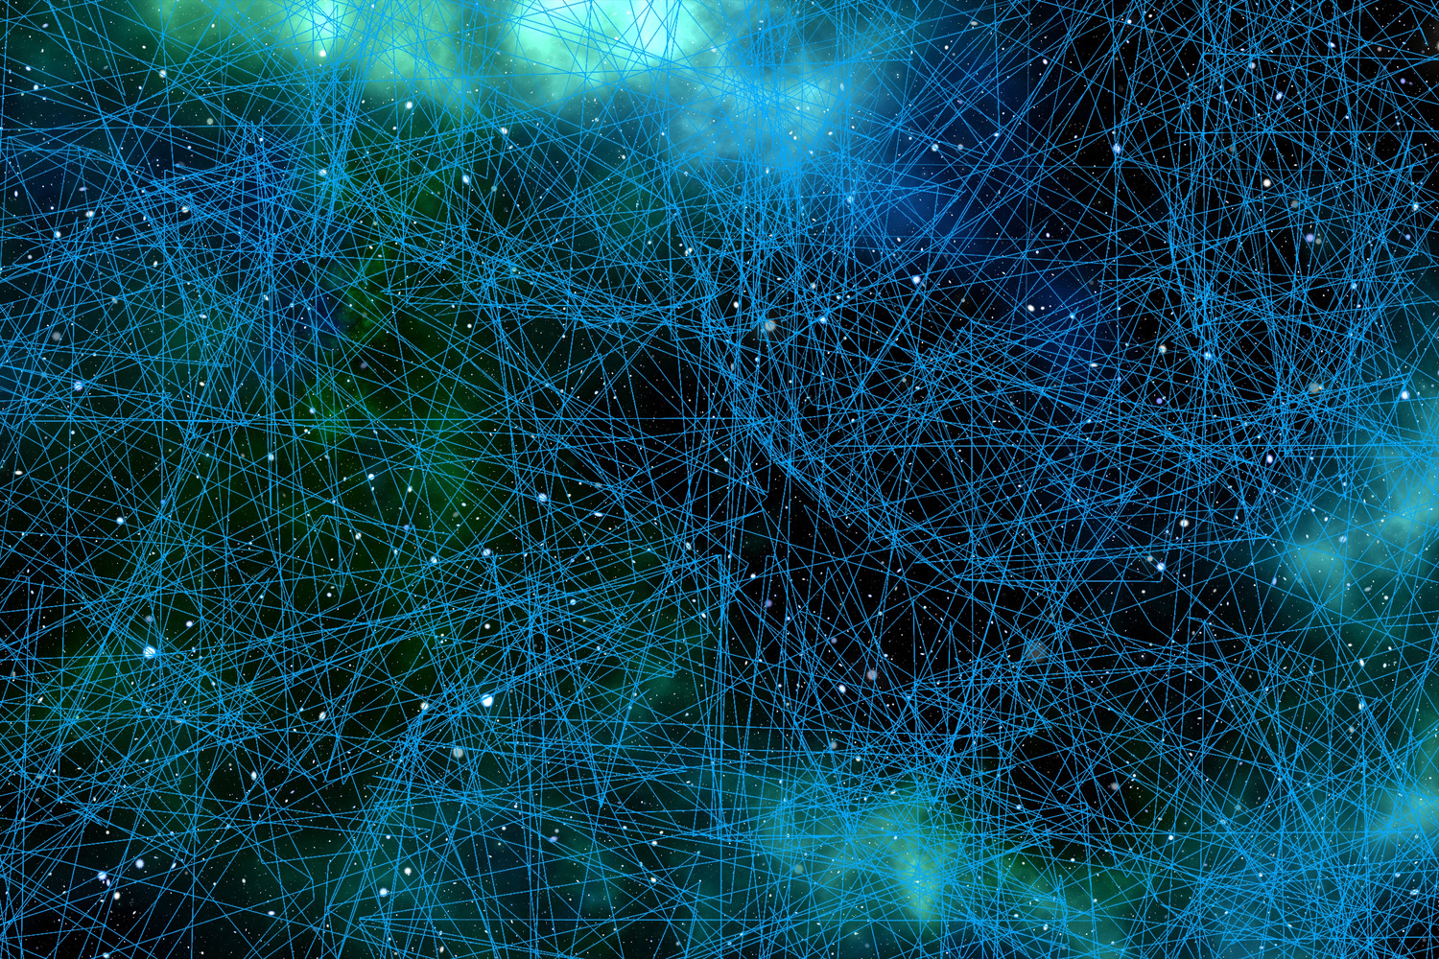


Methodology
Dataset Collection & Preprocessing
CapsNet Architecture Design
Data Augmentation & Training
Model Development & Comparison
Evaluation & Analysis

Slide 9
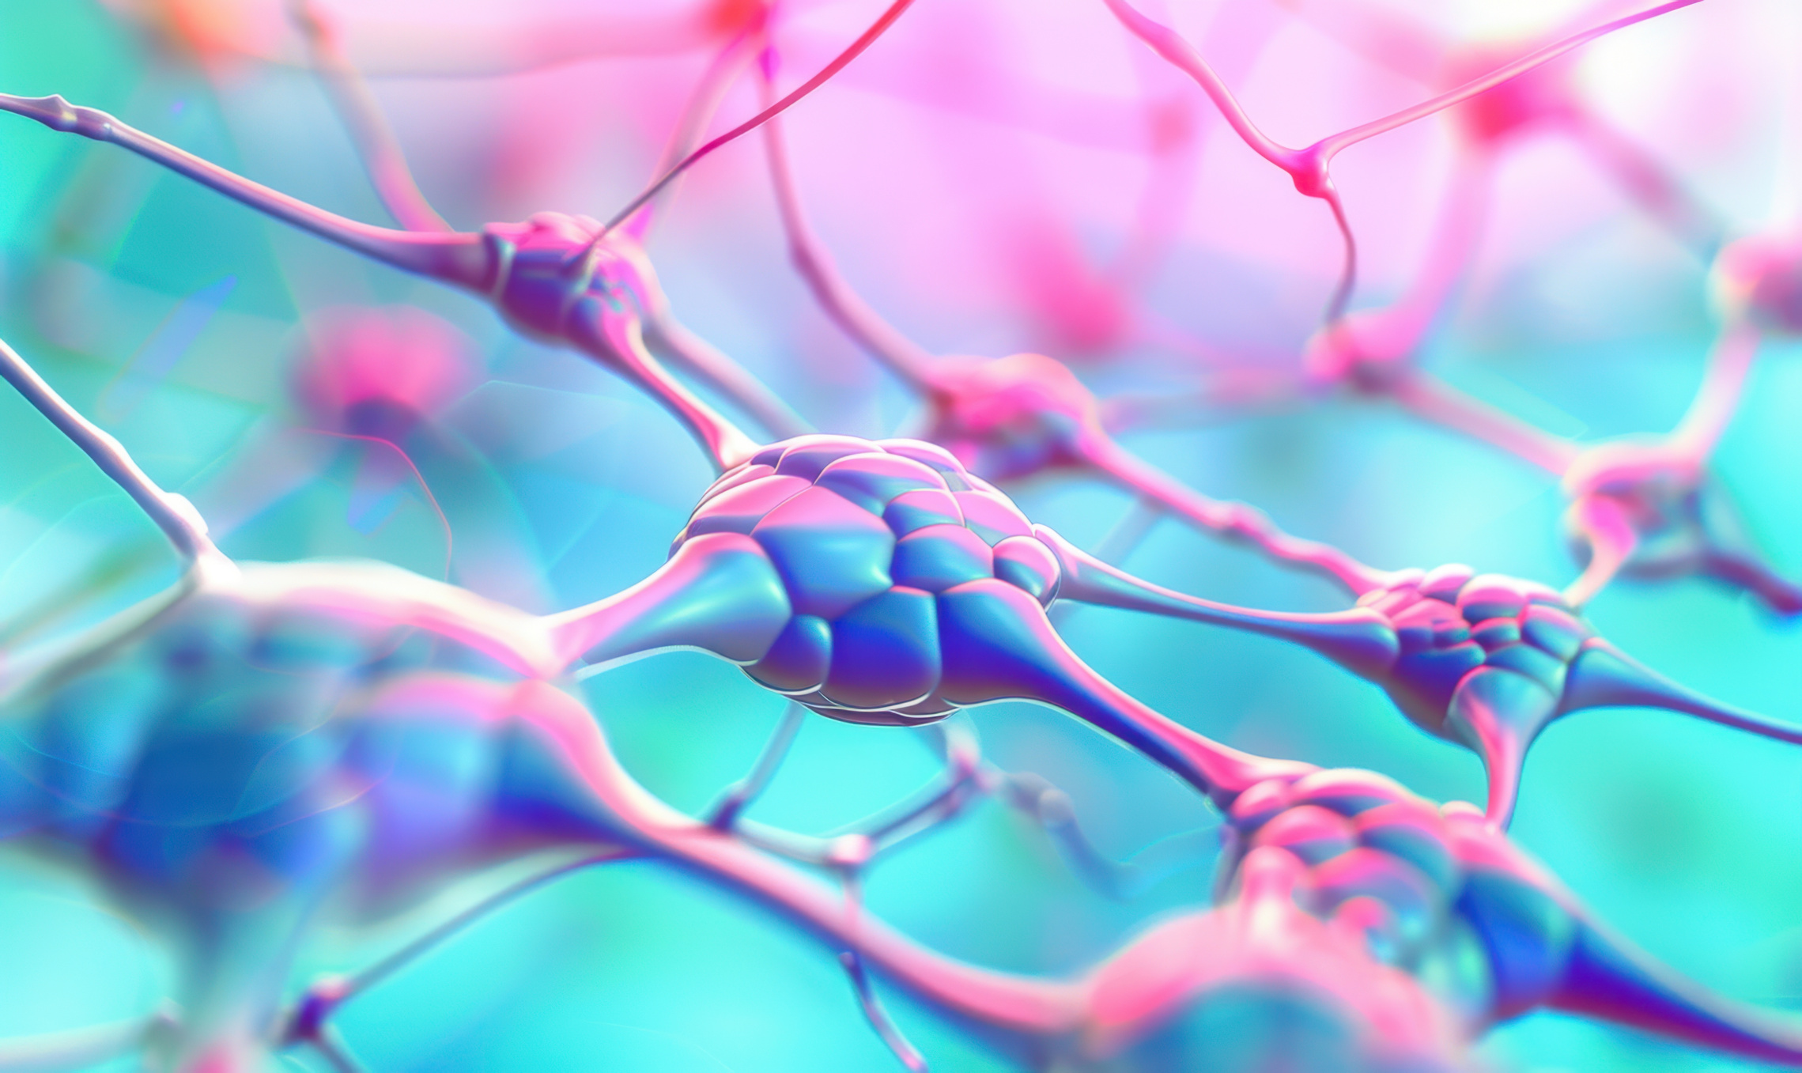
Dataset and Preprocessing
Dataset: LIDC-IDRI (1018 CT scans)
Preprocessing: image resizing, normalization, grayscale conversion
Augmentation: rotation, flipping, contrast adjustment

Slide 10
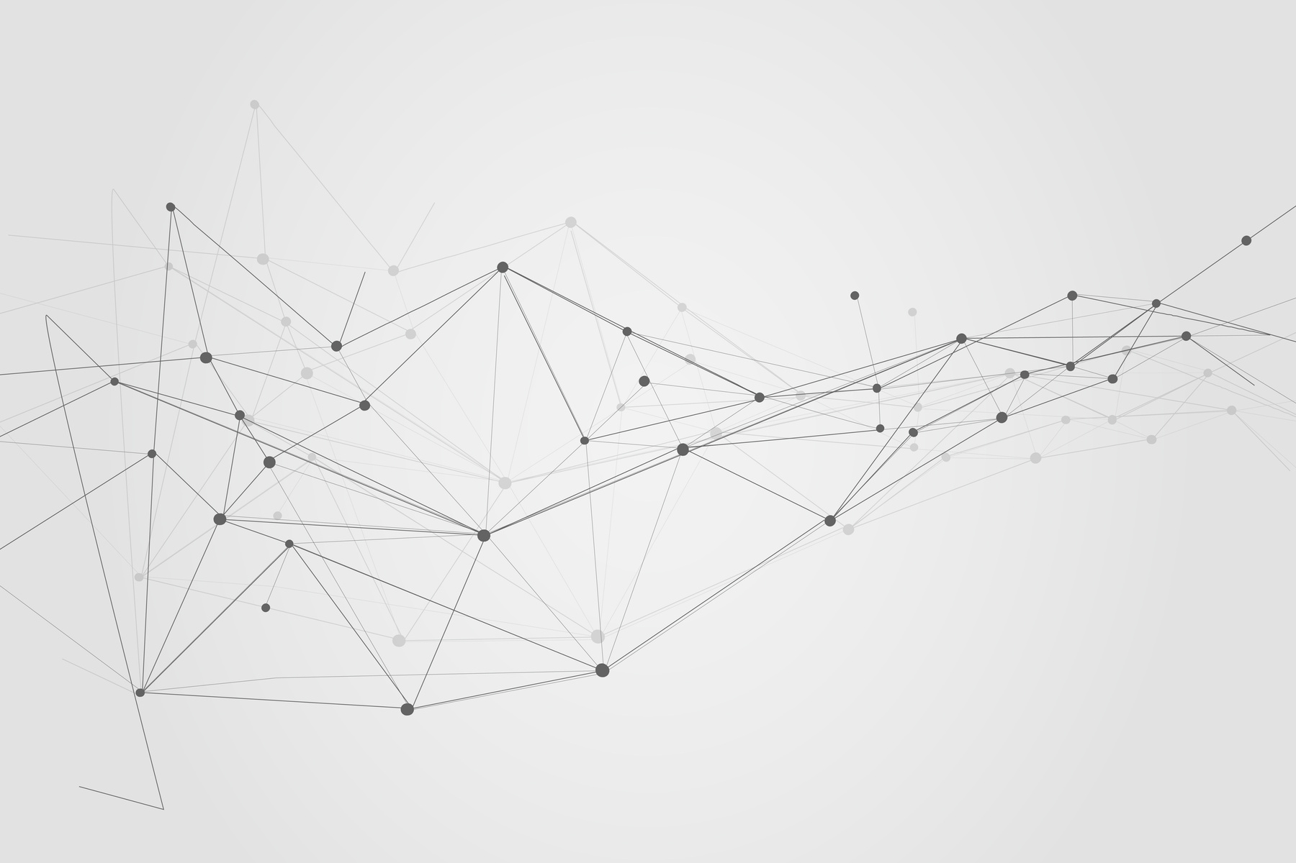
Capsule Network Architecture
3 Architectures:
Basic CapsNet (32 primary capsules)
Enhanced CapsNet (64 capsules, regularization)
Advanced CapsNet (optimized parameters)
Encoder-decoder design with dynamic routing.

Slide 11


Utilization of Research Results
AI-driven healthcare systems for early detection.
Integration in automated screening programs.
Benefits: improved accuracy, reduced false positives.
Contribution to AI and medical research communities.

Slide 12
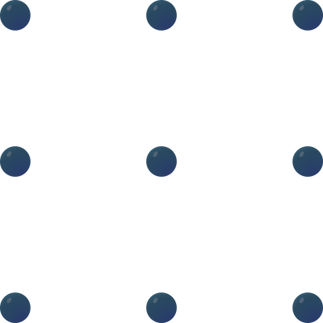


Research Outcomes
Three optimized CapsNet architectures.
Enhanced performance over CNNs.
Framework for clinical deployment.
Deliverables: visual results, ROC curves, confusion matrices.

Slide 13

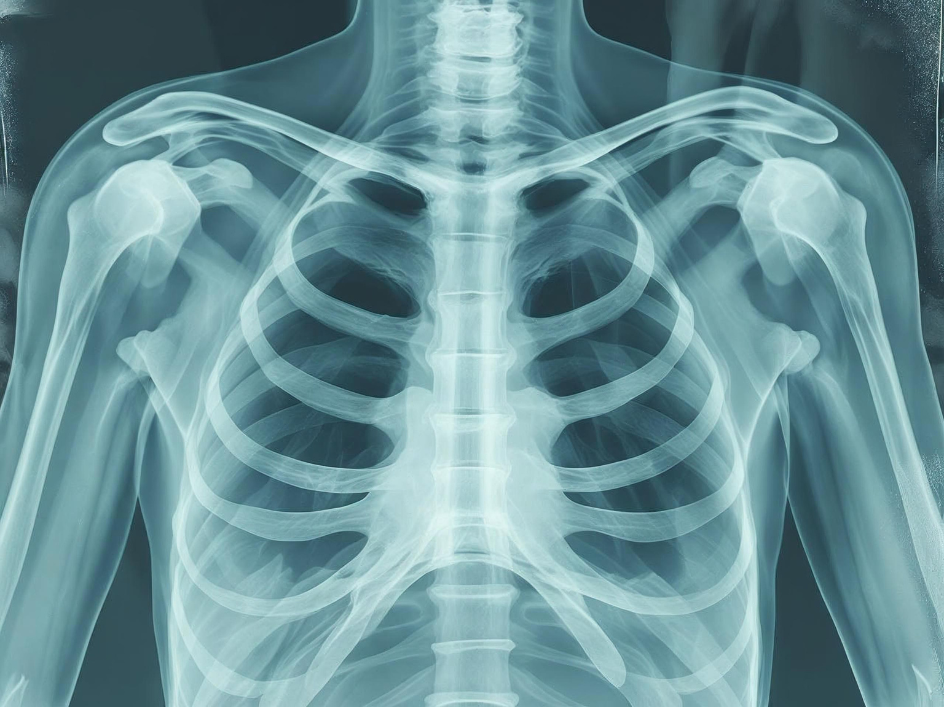


Research Timetable
Month 1: Literature Review & Dataset Collection
Month 2: Data Preprocessing
Month 3: Implement Architecture 1
Month 4: Develop Architectures 2 & 3
Month 5: Training & Evaluation
Month 6: CNN Baseline & Comparison
Month 7: Results & Documentation
Month 8: Thesis & Defense Prep

Slide 14

References
•[1] Kumar et al., IEEE CRV, 2015
•[2] Kauczor et al., ERJ, 2015
•[3] NLSTR Team, NEJM, 2011
•[4] Sabour et al., arXiv, 2017
•[5] Scherer et al., ICANN, 2010
•[6] Setio et al., arXiv, 2016
•[7] Shin et al., IEEE Med Imaging, 2016
•[8] Song et al., JHE, 2017
•[9] Stewart & Wild, WCR, 2014

Slide 15
THANK YOU

